Slide 1

HANDWRITTEN CHARACTER RECOGNITION
Under the Guidance of
A. Rajashekar Reddy
Assistant Professor
Team: 01
16wh1a1201- A.Tejaswini
16wh1a1204- A. Niharika
16wh1a1250- N. Pooja sathvika
16wh1a1254- Y. L. Pratyusha

Slide 2
Contents
Introduction
Problem Definition
Literature Survey
Architecture Diagram
Dataset
Input-Output
Plan of Action
References

Slide 3
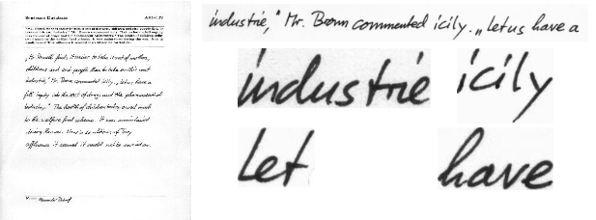
Introduction
HCR i.e Handwritten Character Recognition is also called as OCR (Optical Character Recognition).
HCR is a technique or ability of a computer to receive and interpret handwritten input from source such as paper document, images etc.
Fig. 1: Handwritten Image taken as input

Slide 4

Problem Definition
To build an application useful for recognizing all English characters.

Slide 5
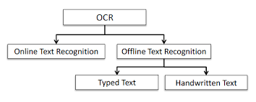
Literature Survey

Slide 6
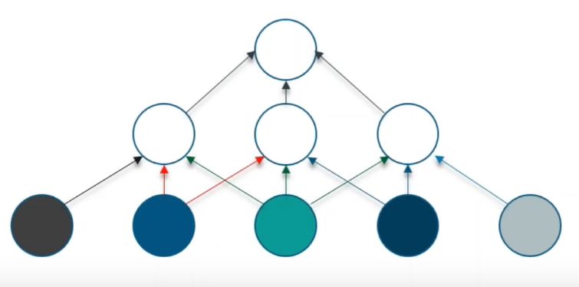
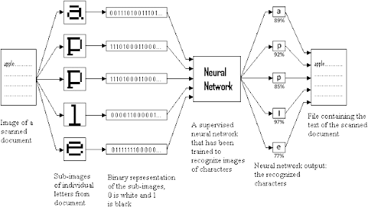
Architecture Diagram - CNN

Slide 7
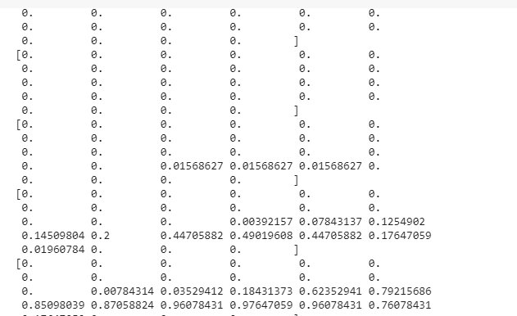
Data Preprocessing
V

Slide 8
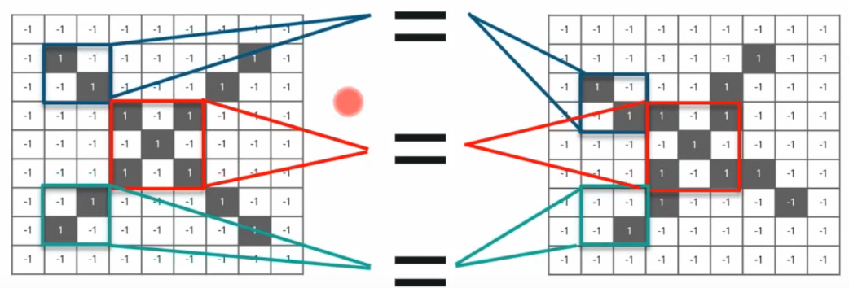
CNN-Convolution Layer

Slide 9
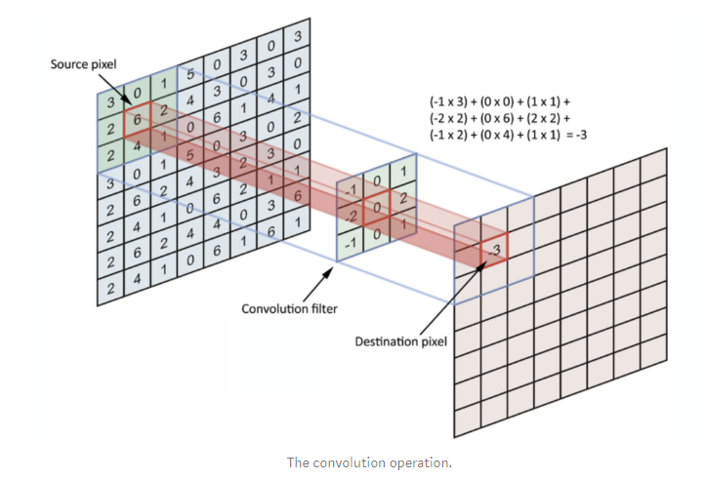
.

Slide 11
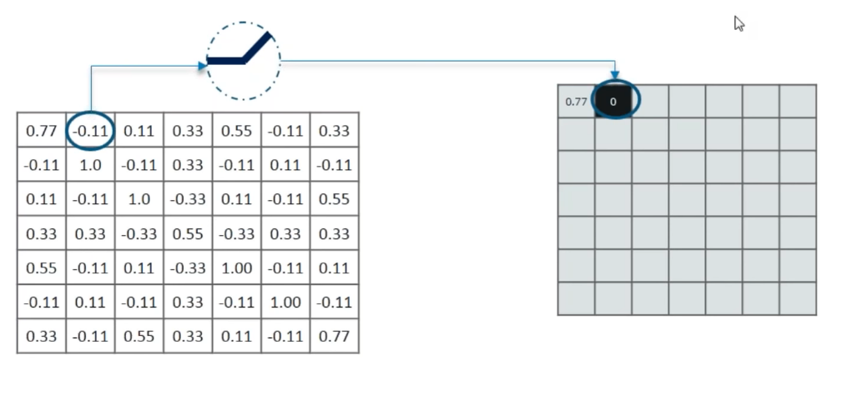
ReLU

Slide 12
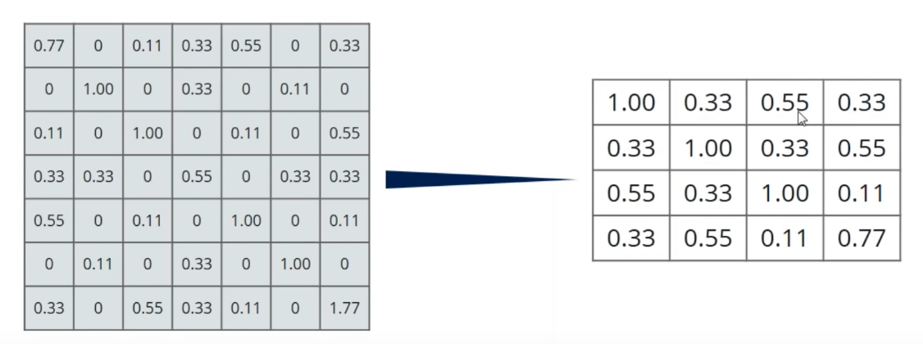
Pooling Layer

Slide 13
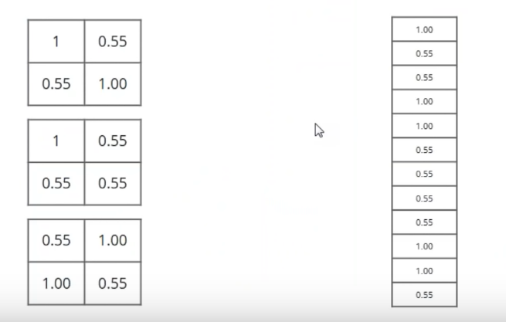
Fully Connected Layer

Slide 14
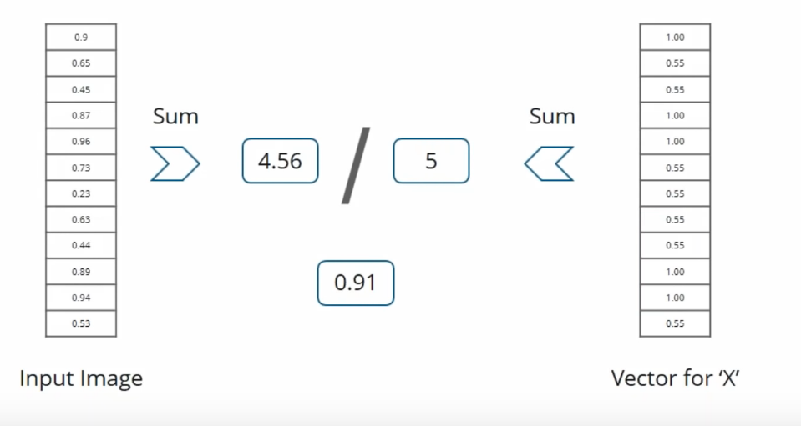
Predicting the ‘X’ Value

Slide 15
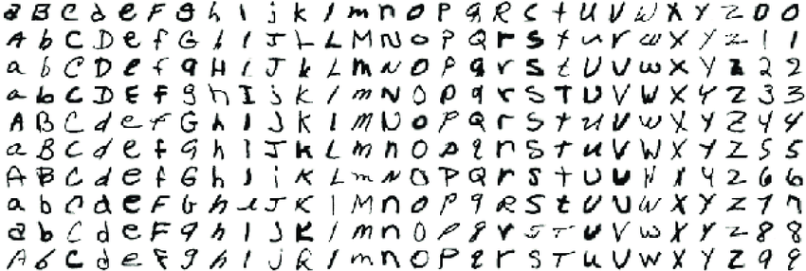
Data Set - EMNIST
.

Slide 16
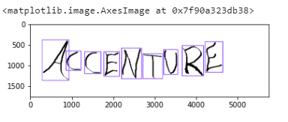
Input

Slide 17
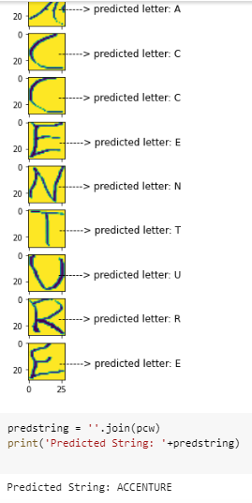
Output

Slide 18
Action Plan
Module Information | Status | Time required to Complete
Literature Survey | Completed | 1 week
Requirement Analysis | Completed | 1 Week
Design | Completed | 2 Week
Implementation | Completed | 4 Week
Documentation | Completed | 2 Week
Final Submission

Slide 19
References
https://ieeexplore.ieee.org/document/8473291
https://www.ijitee.org/wp-content/uploads/papers/v8i6s4/F12940486S419.pdf
https://ieeexplore.ieee.org/document/8741412
https://elitedatascience.com/keras-tutorial-deep-learning-in-python
https://www.youtube.com/watch?v=umGJ30-15_A

Slide 20

.

